Slide 1


WoW CS-GY 6083 - B, Spring 2022 Principles of Database Systems
Qifan Zhang (qz2028)
Zhen Wang (zw2655)
Haoran Wang (hw2525)
05/12/2022

Slide 2
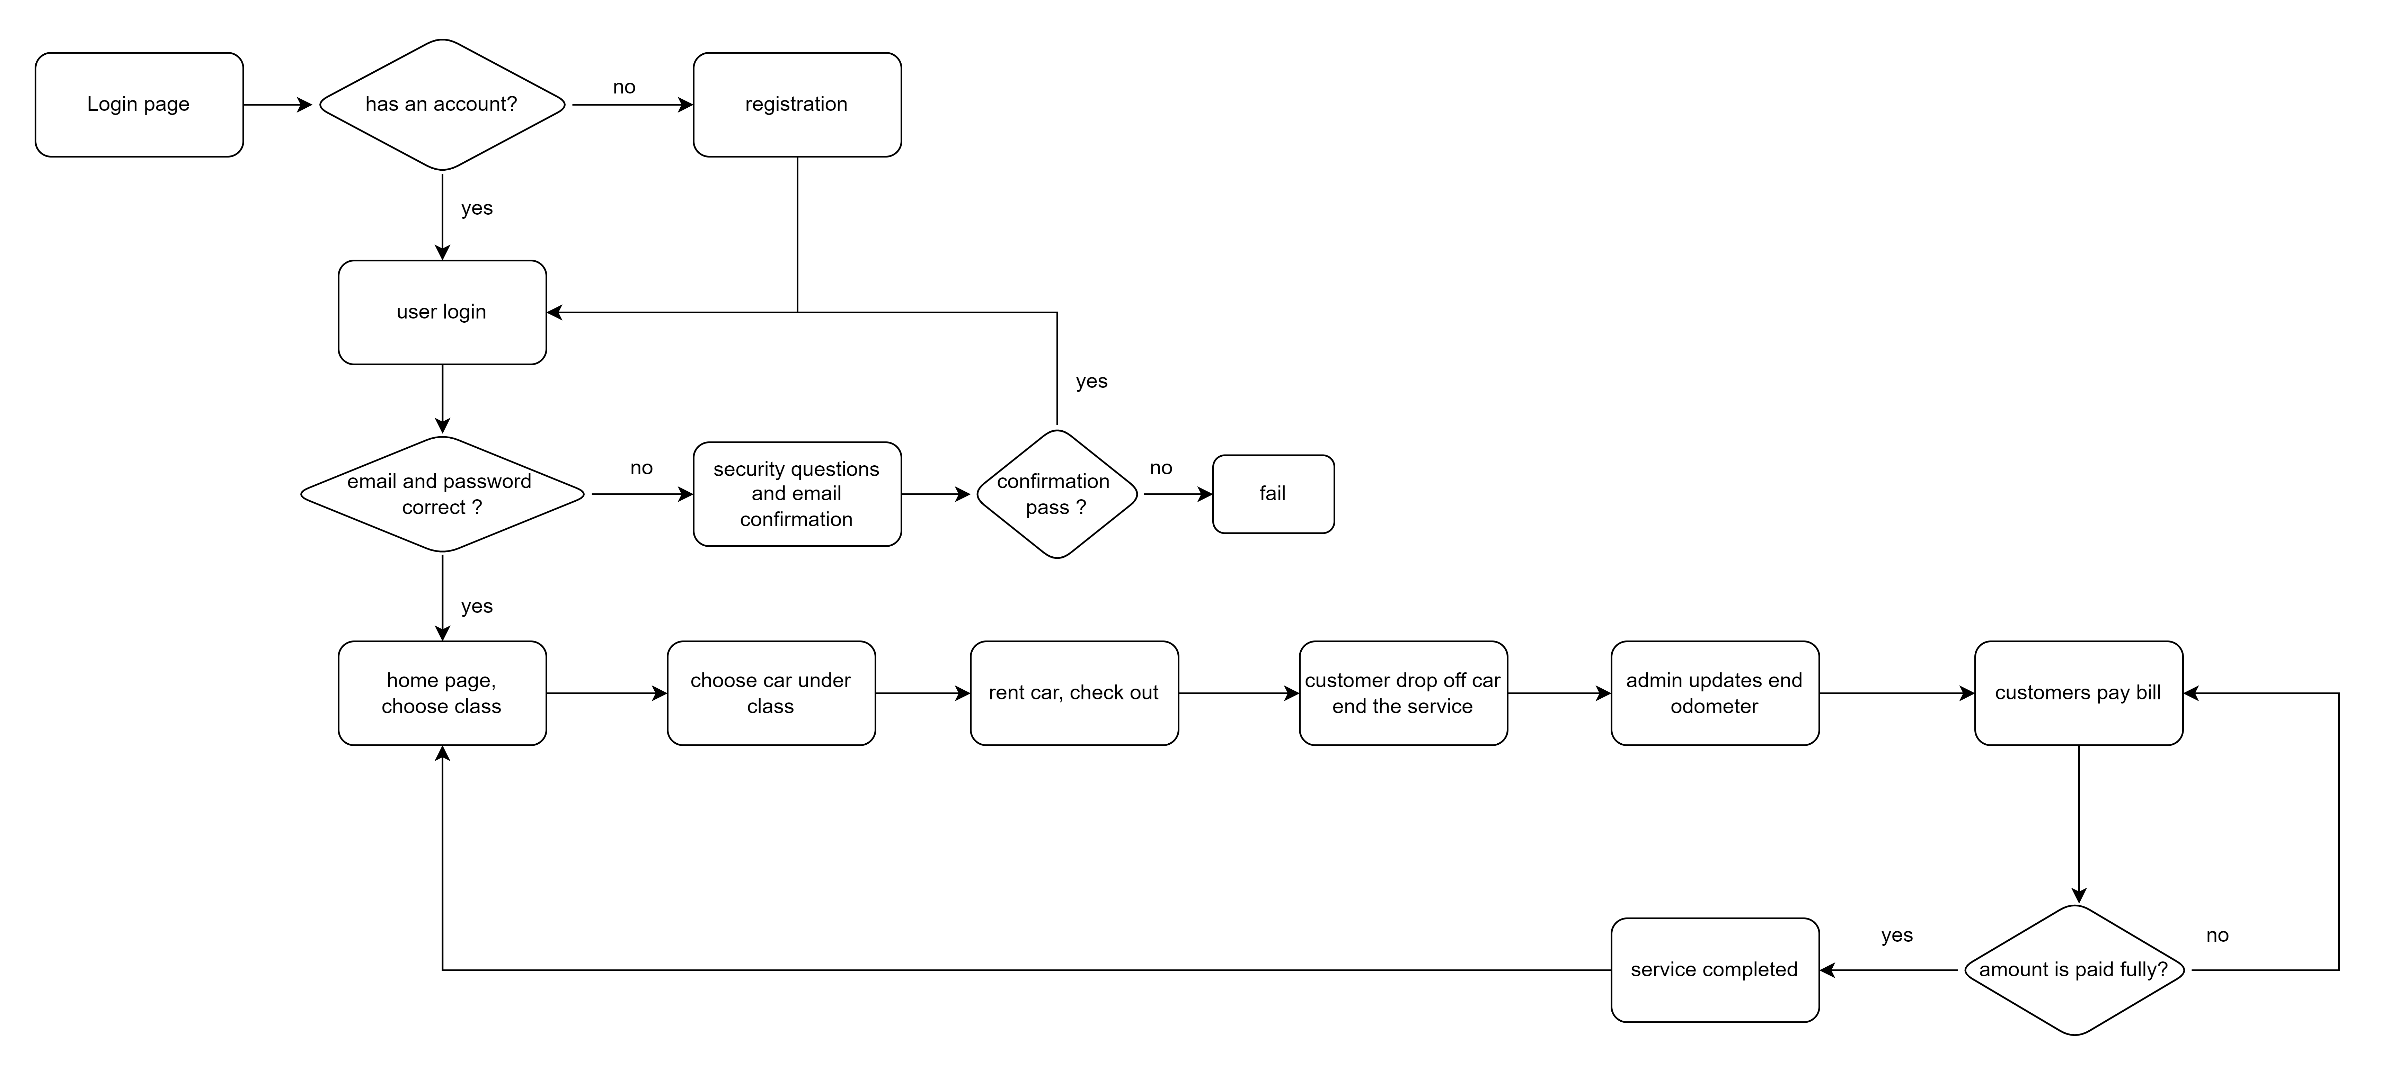
Project Flow Chart

Slide 3

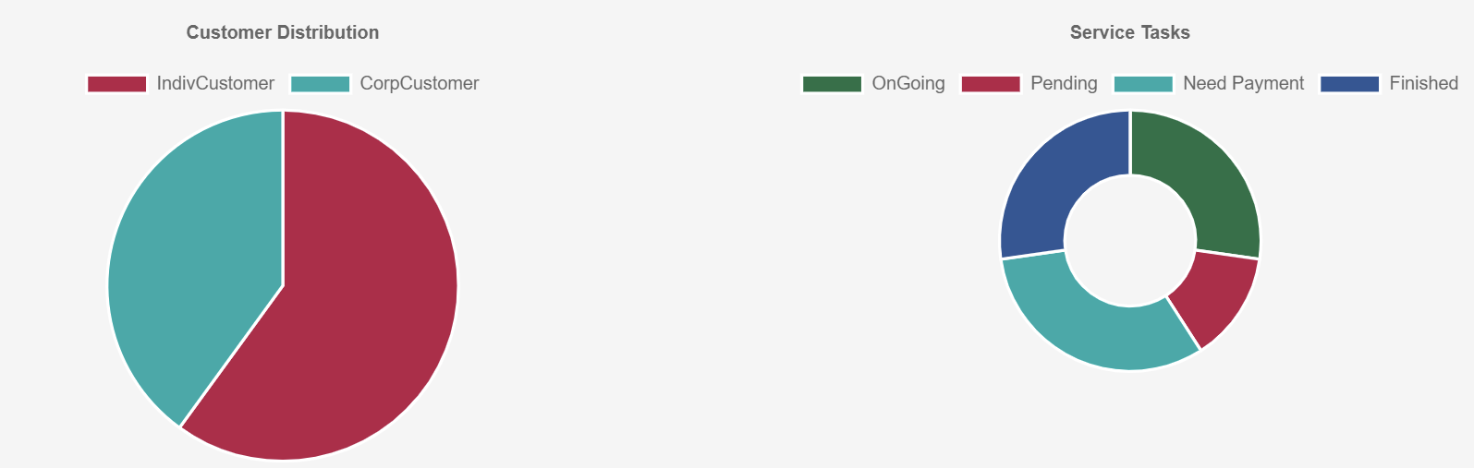

Features
Cloud-based and database and applications on Docker
Cookie-based remember-me feature
Separate customer website and admin website
Data visualization
Dynamic statistic data charts
Beautifully designed web pages and high-definition pictures
Security question on Password Reset
Security
CSRF protection
Website access control
SQL injection prevention

